Slide 1
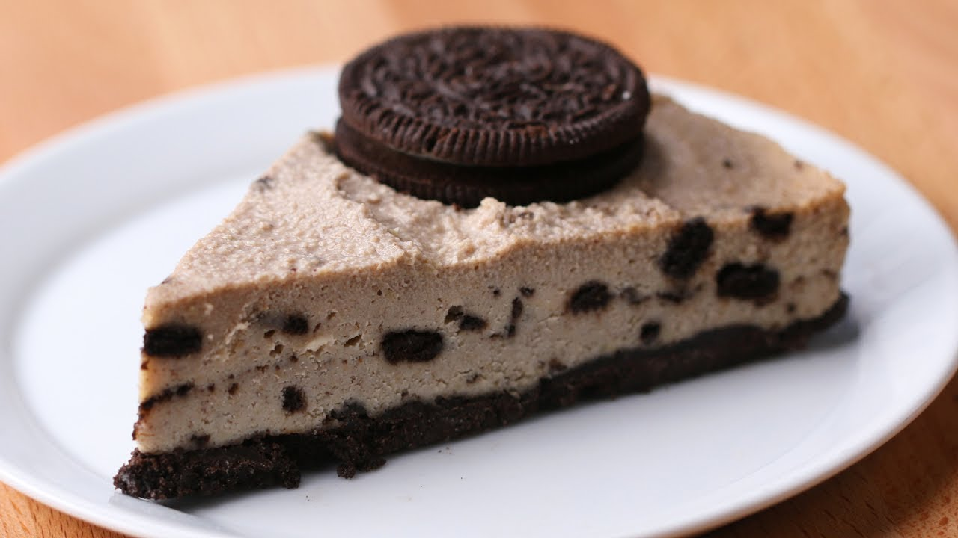
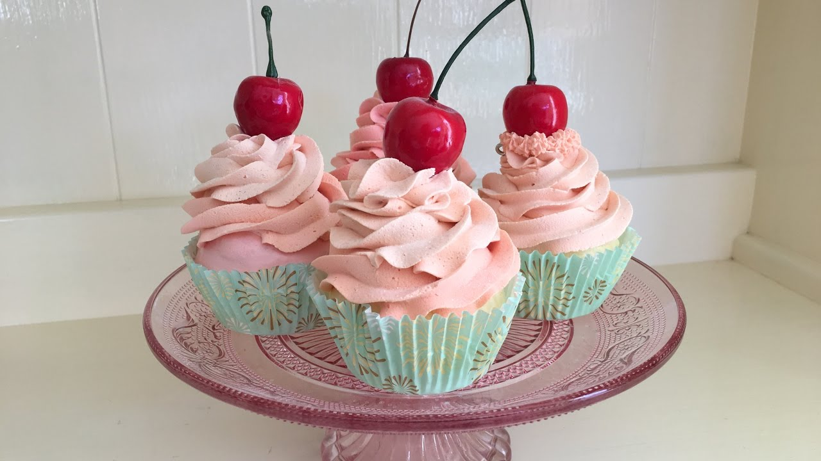
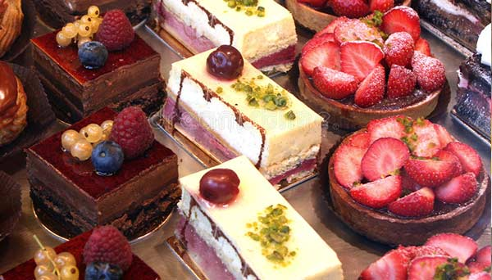
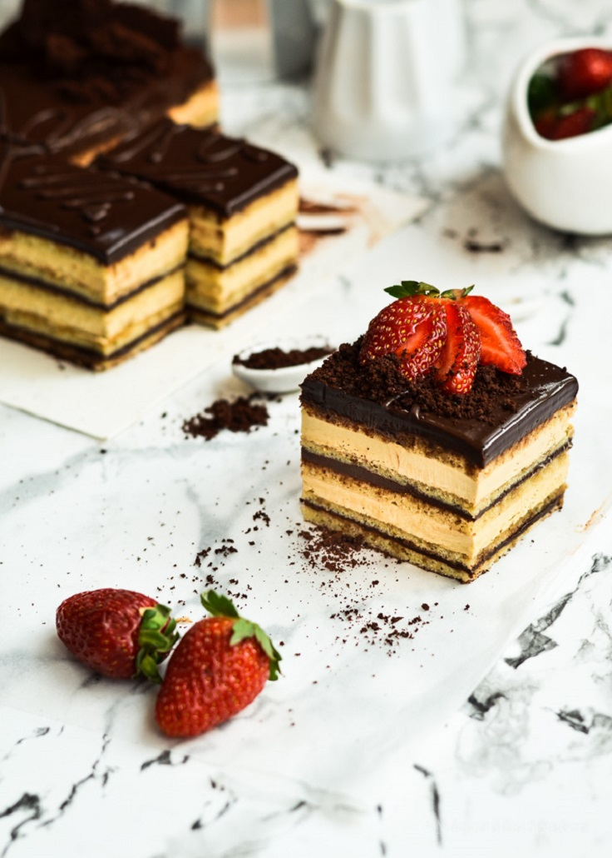
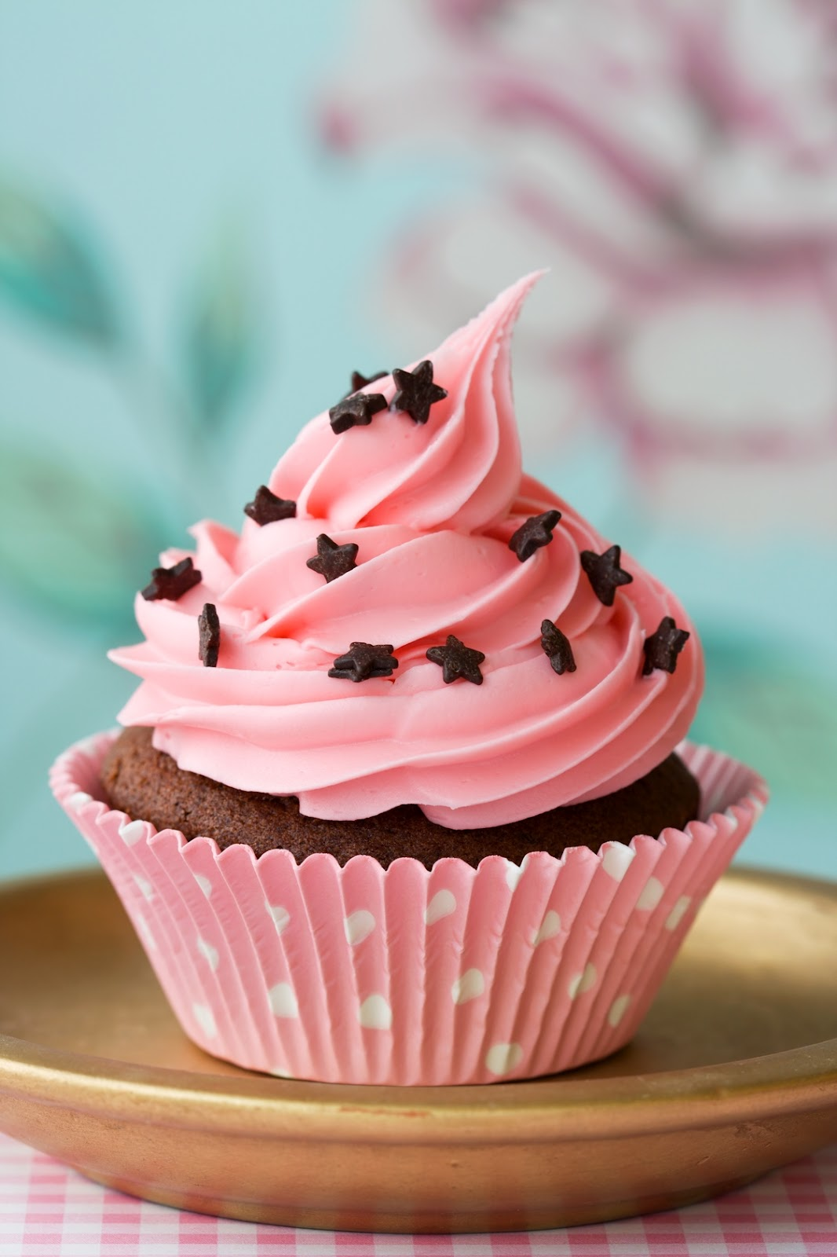
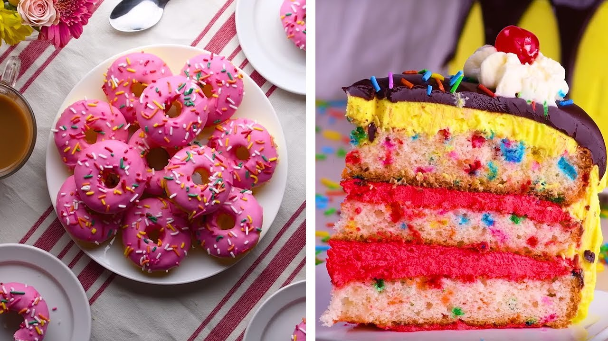
Little Miss Cupcake
And Her Very Unhealthy Diet
By Darcy Weir

Slide 2
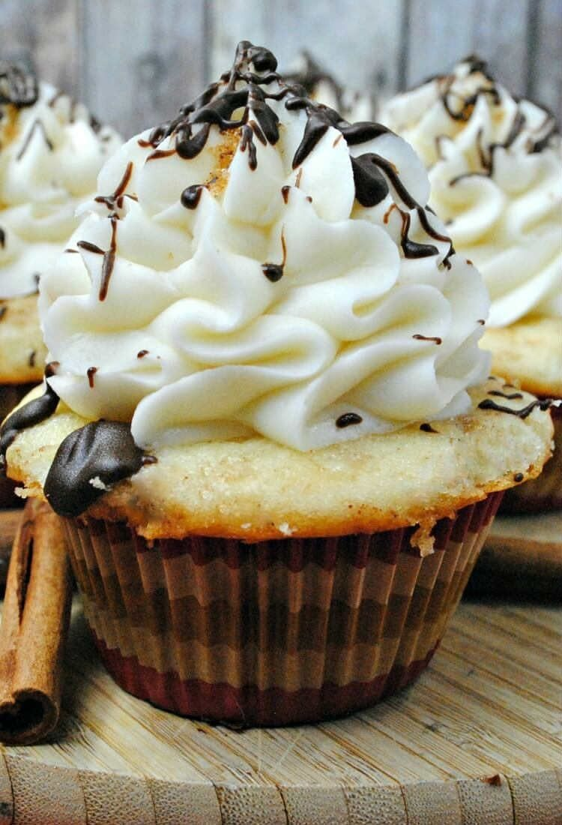
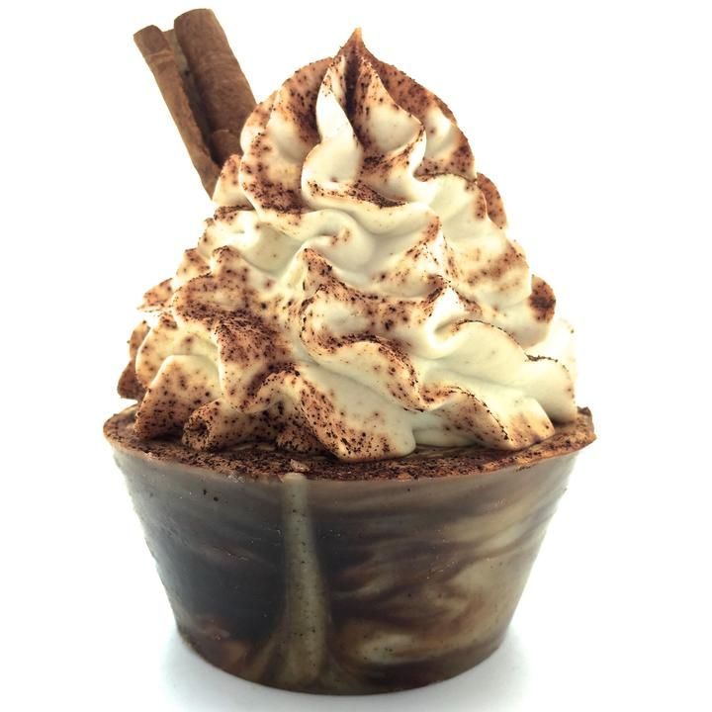
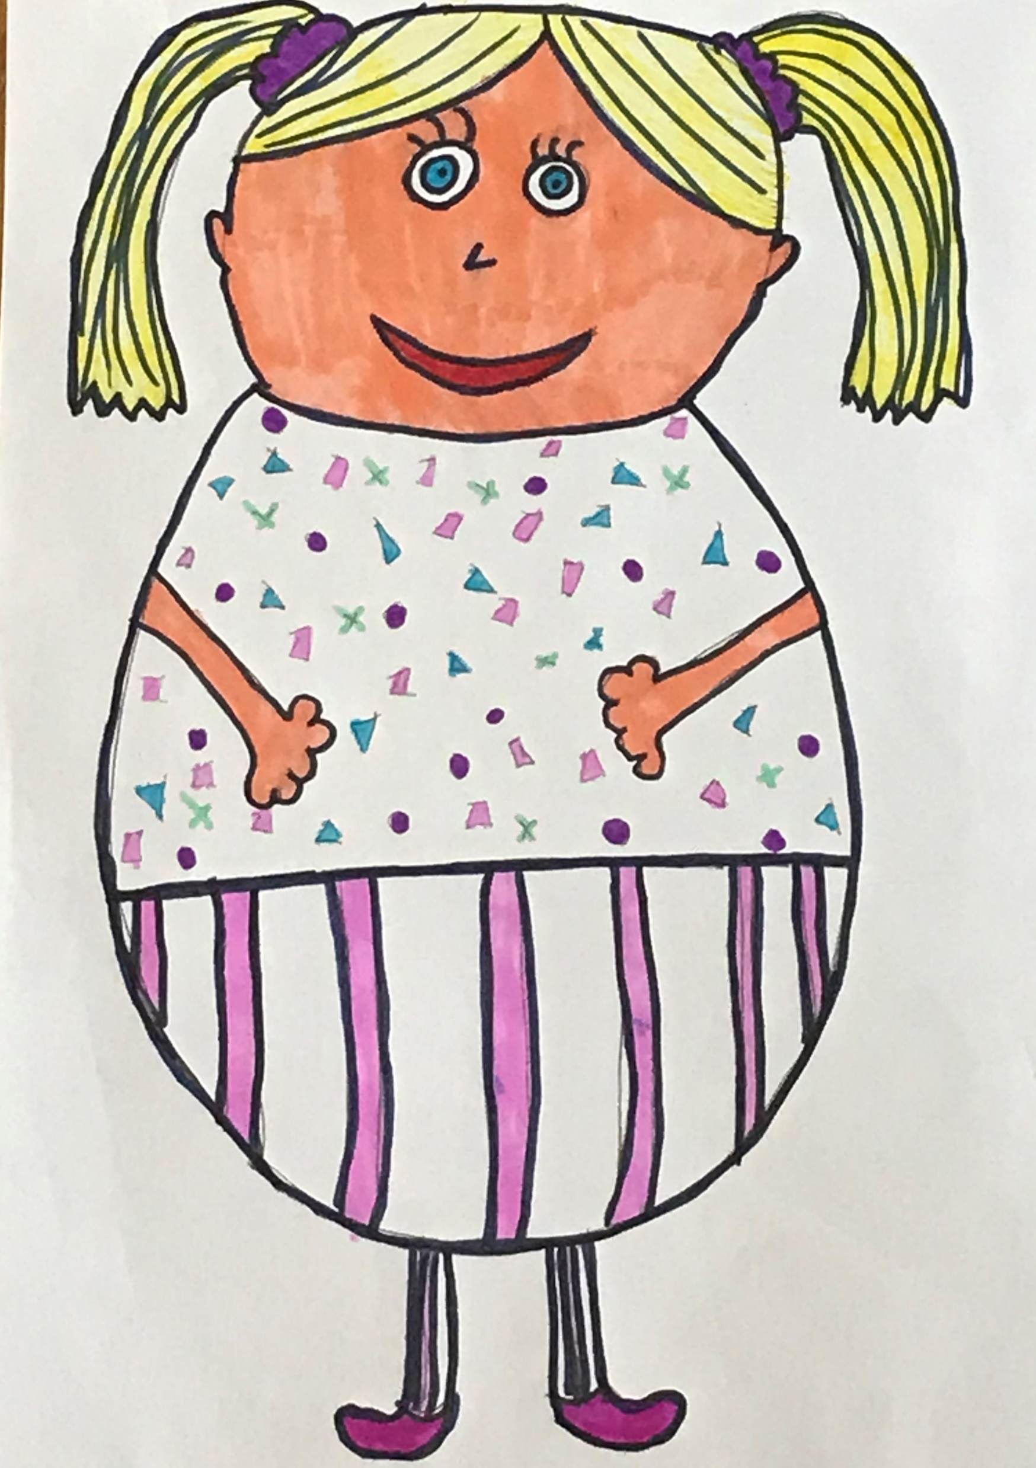
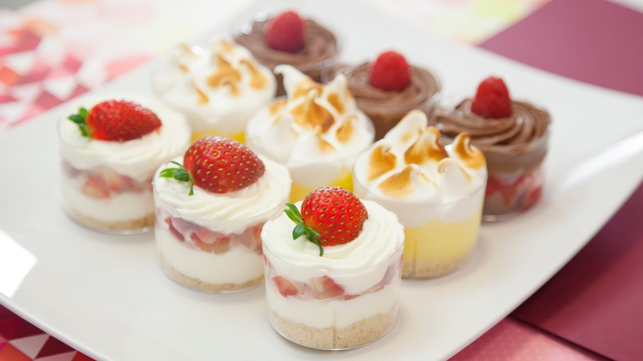
This is Little Miss Cupcake. She loves, you guessed it, cupcakes, buns and desserts .

Slide 3
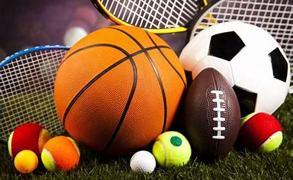
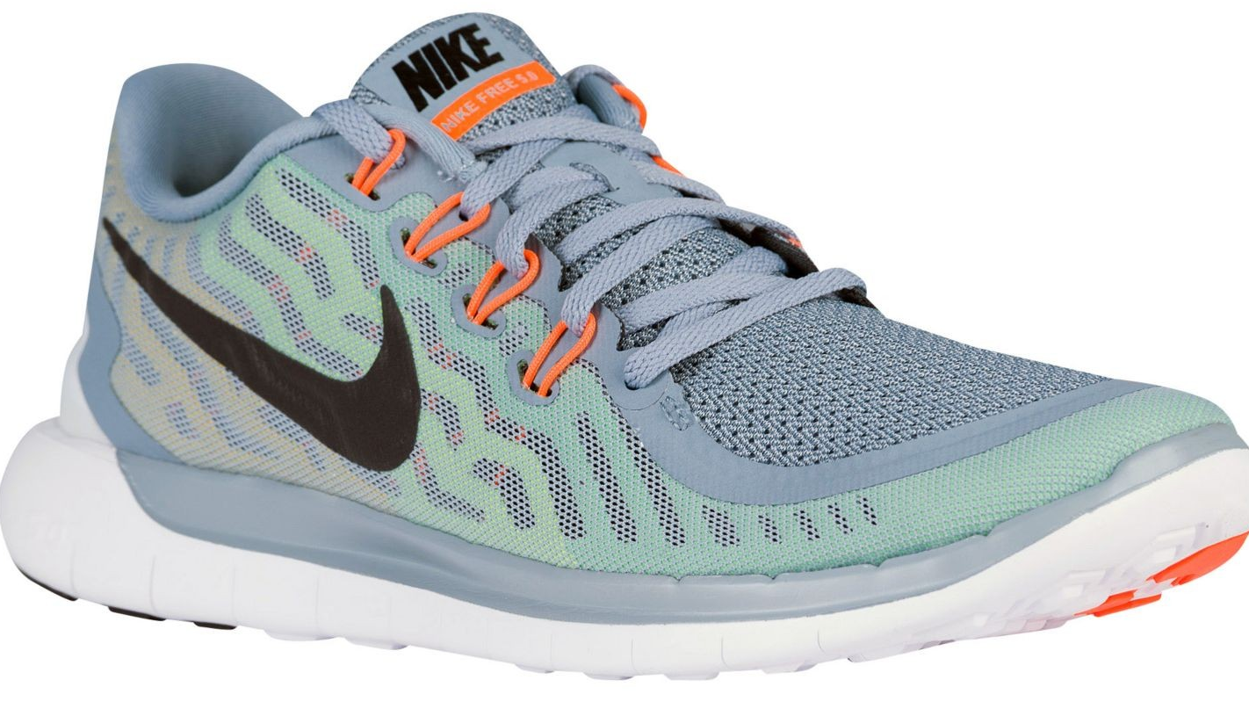
Little Miss Cupcake was a little out of shape. She hated anything healthy and absolutely dreaded sport .

Slide 4
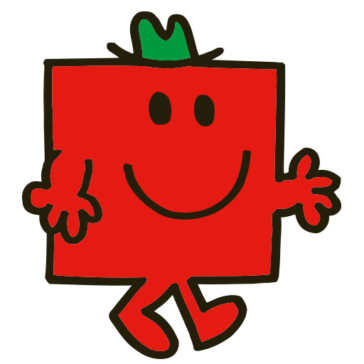
Although there was one very healthy man in town, he was Mr Strong, he was very healthy especially compared to Little Miss Cupcake .

Slide 5
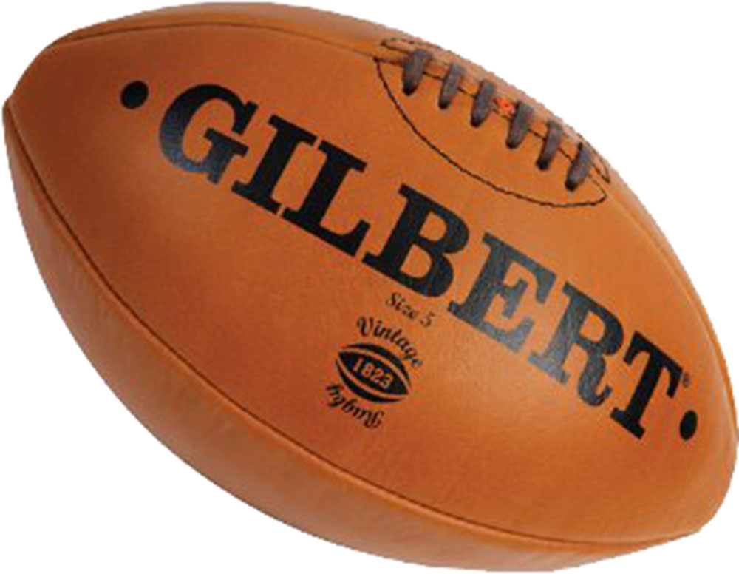
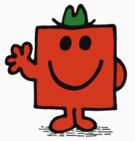
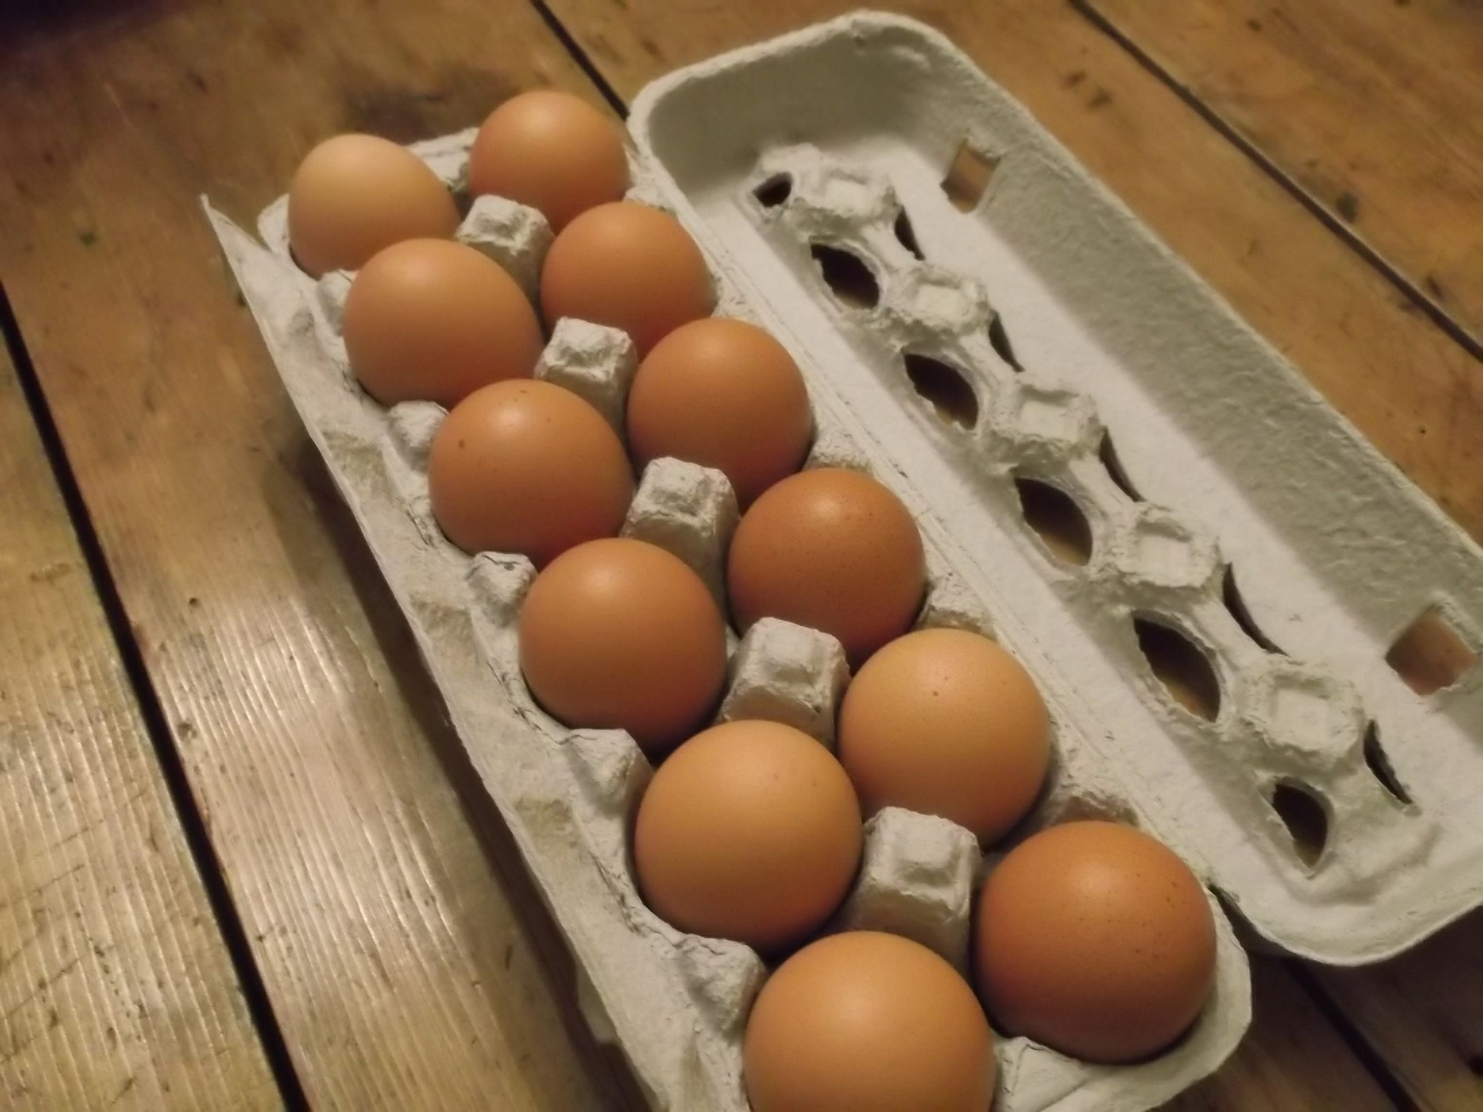
Mr strong plays rugby and eats 12 eggs every morning for his breakfast .

Slide 6
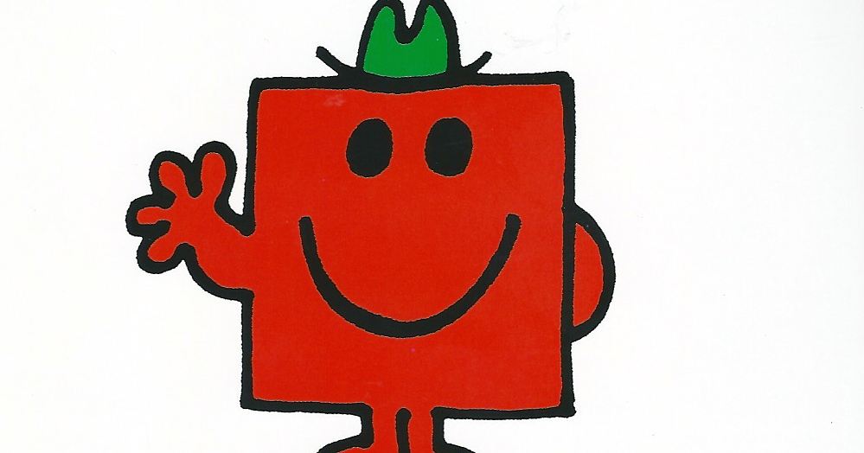
One day Mr Strong and Little Miss Cupcake met in town. Little Miss Cupcake tried to offer Mr Strong a cupcake and Mr strong tried to give Little Miss Cupcake some egg but they both refused.

Slide 7
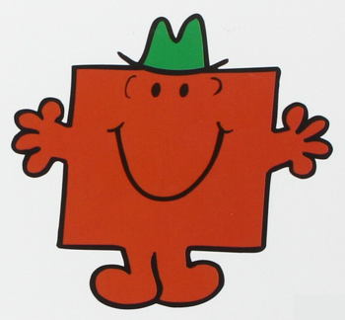
Little Miss Cupcake and Mr strong sat and chatted for a while and together they figured out that neither of them was really healthy. They decided that you need a balanced diet, you can’t eat loads of eggs because that is too much protein, but you also definitely can’t eat just buns and desserts.

Slide 8
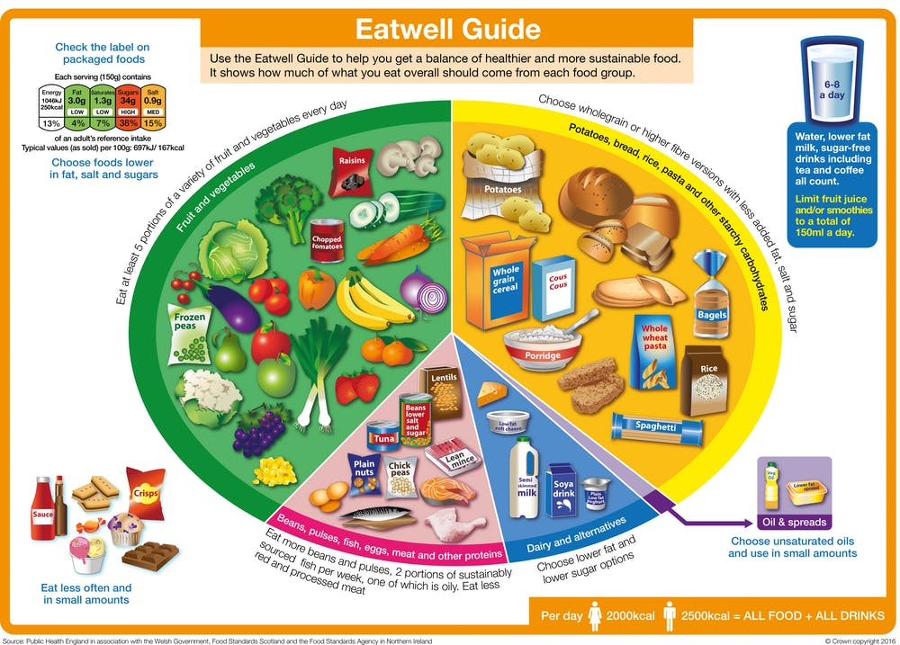
So they came up with a plan!

Slide 9
The End
The lesson in the story is that you need a healthy balanced diet.
By Darcy Weir

