Slide 1
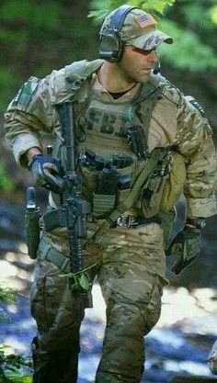
Mr F.B.I
Mr. F.B.I is a special agent with the F.B.I, He is very well dressed, he owns a very fast supercar and he is the 6th time winner of ninja warrior. He can be serious but also funny, and always has a laugh with his friends. In the F.B.I he works in the F.B.I Hostage rescue team.

Slide 2
Fortnite - Hacked
One day he got a call from an unknown number the caller said” ha ha ha I hacked into Fortnite and deleted everyone’s accounts “and put down the phone. Right away Mr F.B.I knew who it was, it was Vex.

Slide 3
Vex – The Villain
Vex is one of the most wanted villains in the world. Mr F.B.I went to the F.B.I headquarters and told everyone to look for Vex. We can save Fortnite together. Immediately everyone got on their computers to track Vex down. They couldn’t find him and so all the kids were really sad.
.

Slide 4
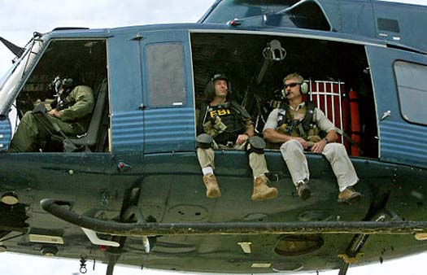
The Capture
After working all night, they found where the villain lived. Immediately Mr F.B.I sent out two helicopters to capture the villain. The helicopter arrived and landed in the felid next to the house there were 22 SWAT soldiers all together, The F.B.I SWAT broke down the door and ran into the building. they looked around and then found him on his couch, they put him in handcuffs and he was off to jail.

Slide 5
The End
They still had one thing left to do, they needed to get everyone’s account back. So, the F.B.I hired the best hacker that they could find. He managed to hack into to Fortnite and gave everyone’s account back to them. Then Mr F.B.I said “I’ll have a go at this game” so the hacker passed him a controller and he tried it out and got the victory on his very first game. Well done Mr F.B.I.

Slide 6
The Moral of The Story
The moral is to always work hard and never give up.

